Slide 1
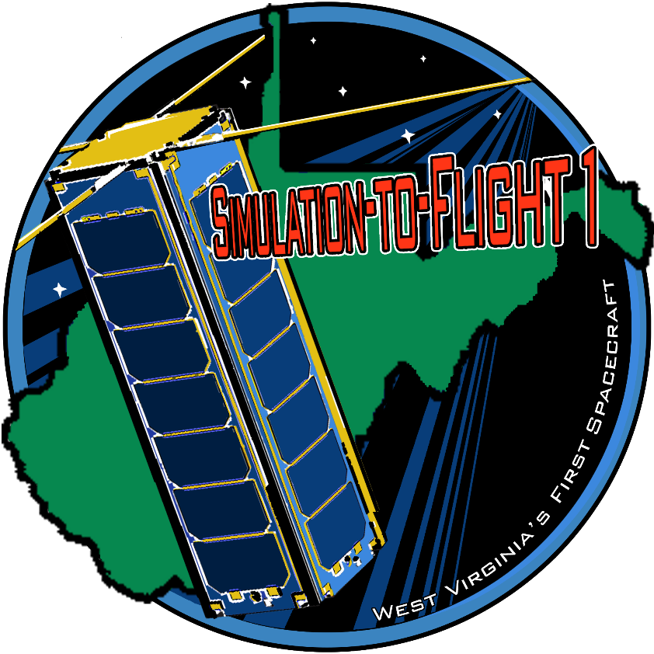




Simulation-to-Flight 1
NASA IV&V
John Lucas
John.P.Lucas@nasa.gov
www.stf1.com

Slide 2
Simulation-to-Flight 1
West Virginia’s First Spacecraft
NASA CubeSat Launch Initiative (CSLI)
  ELaNa XIX, Rocket Labs USA
  85 inclination at 500km altitude
  Mission Readiness Review: March 2017
  Delivery: April 2017
  Launch: June 2017
Partnering with GSFC/WFF Small Satellite Teams
NASA Independent Verification and Validation (IV&V)
  C&DH hardware/software, integration and testing
West Virginia University (WVU)
  Science payload hardware and software
West Virginia Space Grant Association (WVSGC)
  Statewide outreach

Slide 3
Areas of Focus
STF-1 NOS³ | Primary Objective | NASA IV&V
GPS and IMU | Science Objective 1 | WVU MAE
Space Weather | Science Objective 2 | WVU Physics & Astronomy
III-V Nitride Materials | Science Objective 3 | WVU LCSEE
Earth Viewing Camera | Science Objective 4 | NASA IV&V
STEM Education | Outreach Objective | WVSGC

Slide 4
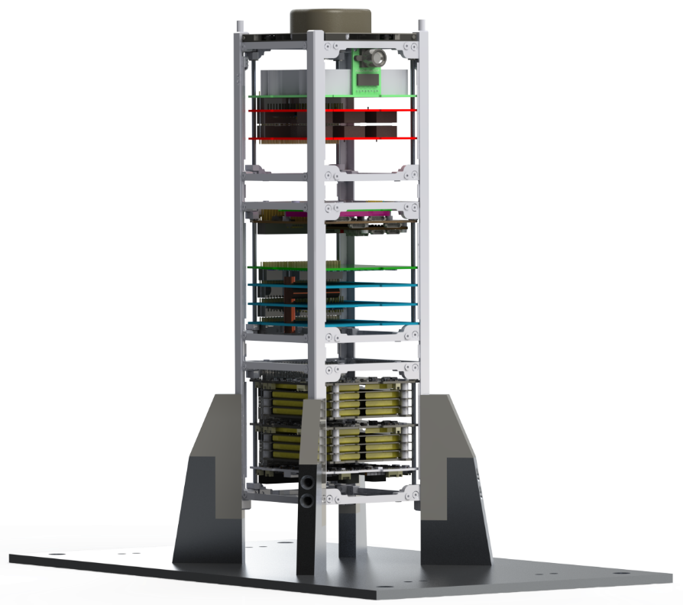
Anatomy of STF-1
ISISpace UHF/VHF Antenna
Deployable Di-pole system
Four alloy tape antennas
Up to 55cm in length
ArduCAM Mini Camera
2MP, I²C and SPI
Optional filters
Gallium III-V Nitride Payload
Three different LED carriers
Measure effects of shielding
L3 CADET Radio
Half duplex UHF
Store and Forward
4GB memory buffer
3.0Mbps with 18M dish
Novatel OEM615 GPS
On-orbit reprogrammable
Precise orbit determination
Open loop tracking
Data: 100Hz phase, TEC, S4
GomSpace Nanomind A3200
AVR32 w/ 512KB flash
125Mb NOR flash
32MB SDRAM
I²C, UART, and CAN-Bus
Inertial Measurement Unit
32 MEMs sensors
Account for errors via calibration pre-flight
Physics
Particle detector
VLF receiver
Plasma probe
ClydeSpace EPS
10 command-able switches
Provides 3.3V, 5V, and 12V
Optimized for LEO
Three independent battery charge regulators (BCRs)
ClydeSpace 40WHr Batteries
Lithium Polymer
Independent for redundancy
Internal headers

Slide 5

NASA IV&V Objective
Demonstrate development lifecycle value of a software-only SmallSat simulator
Objectives
  Open source CubeSat risk reduction solution
  Produce evidence of cost and time savings
  Develop advanced toolset to identify & resolve software issues (Share this technology with the GSFC SmallSat teams)
  Perform meaningful science driven from research institutions
  Foster and spread knowledge throughout IV&V Program

Slide 6

NASA Operation Simulator for Small Satellites
What is ?
  An open source software test bed for small satellites
  A collection of Linux executable and libraries
  Current simulations based on COTS HW from STF-1
  Easily-interfaces to cFS FSW, but not required
Why should you care?
  Shift FSW development forward
    Provides real-world inputs with development environment
  FSW V&V
    Testing FSW, invalid inputs, behavior, stress conditions
  FSW Integration
    Used for early-app development and payload team integration
  Mission Planning

Slide 7
NOS³ Components
Core Flight System (cFS)
  Open source, project independent, reusable FSW framework
COSMOS Ground Station
  Open source, ground system software provided by Ball Aerospace
Hardware Models
  Written for a specific piece of flight hardware
    Focuses on I/O of device and is fully customizable based on vendor options
  Models developed and currently in use:
    Honeywell Magnetometer, ClydeSpace EPS, NovAtel GPS, ISISpace Antenna
NOS Engine
  Middleware specifically designed for use in simulation
    Includes time synchronization, data manipulation, and fault injection
    I²C, UART, and SPI protocols
  Serves as the glue to tie all components to a common interface

Slide 8
NOS³ Components
Orbit, Inview, and Power Planning
  Utilize current or projected TLEs to project contact windows
Vagrant
  Virtual machine is created on-the-fly by the user
  Provides full development environment with all capabilities
  Additional scripts to build and run FSW with simulators provided
42
  Open source, NASA GSFC developed, visualization and simulation tool for spacecraft attitude and orbital dynamics
  Serves as an environmental data provider
    For example provides magnetic field data based on current location

Slide 9
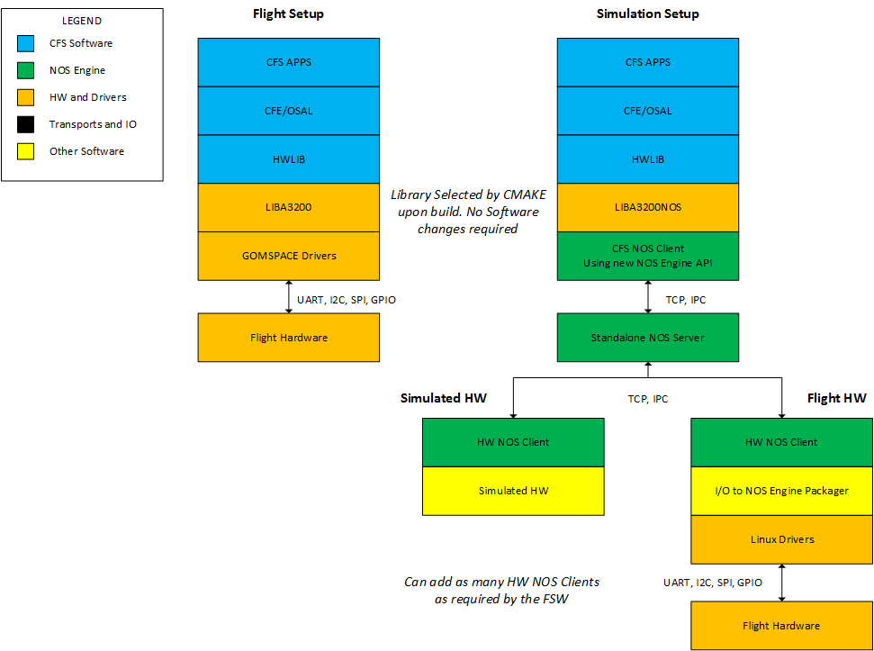

Slide 10
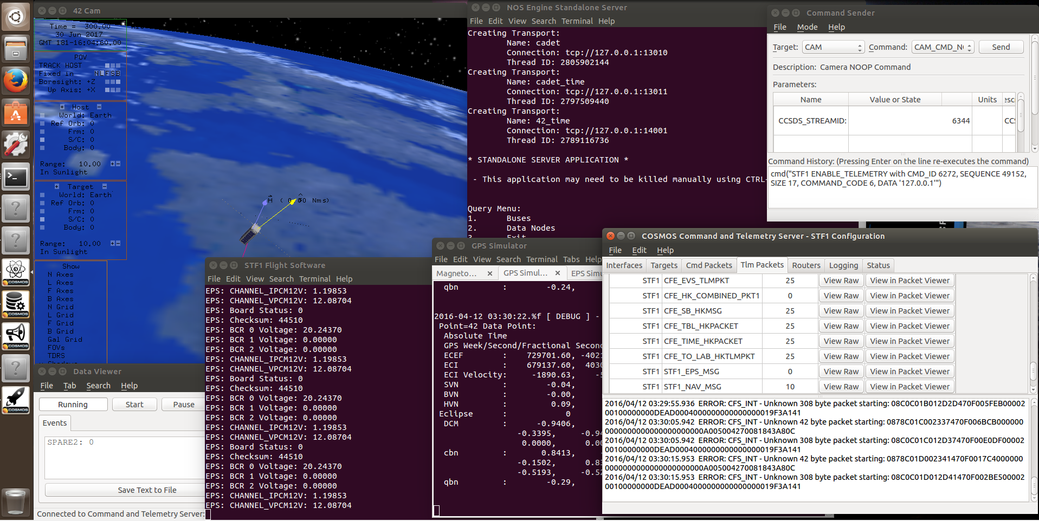
NOS³ In Action

Slide 11
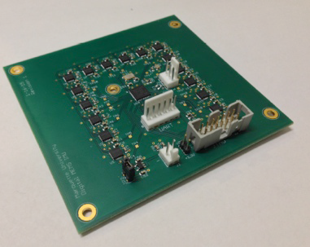
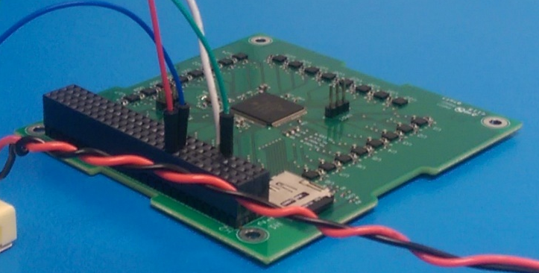
MEMS IMU Swarm
Designed to overcome Size, Weight, and Power (SWaP) constraints
Large cluster of redundant MEMs IMUs
Developed under Small Satellite Technology Partnership (SSTP)
Gen-2 flew on the sounding rocket MUSIC on March 1st
Gen-3 is custom-built for STF-1 in the PC104+ form factor
Gen-2
Gen-3

Slide 12
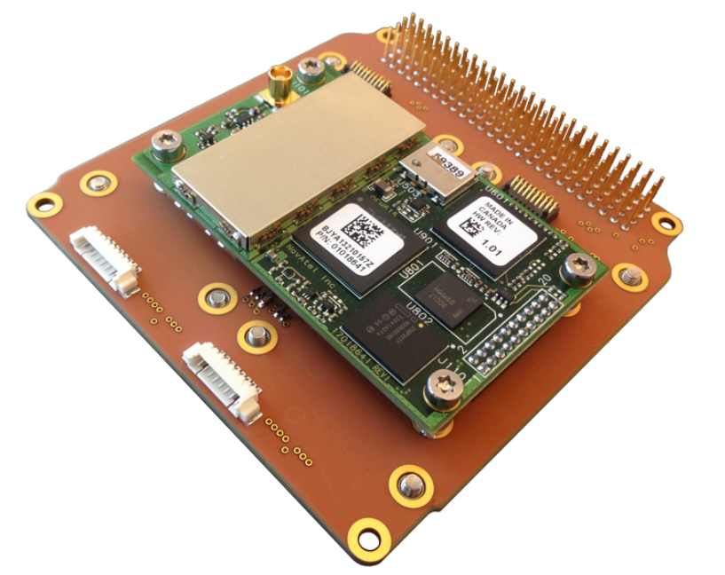
GNSS Receiver and Precise Orbit Determination
NovAtel OEM615 GPS Receiver
Focus to develop and assess estimate strategies that will maximize POD accuracy from data obtained during duty-cycled operations
Post processing utilizes
NASA JPL’s GIPSY-OASIS
package
GPS mounted to Motherboard

Slide 13
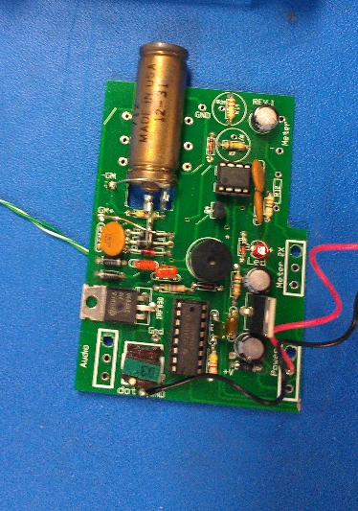
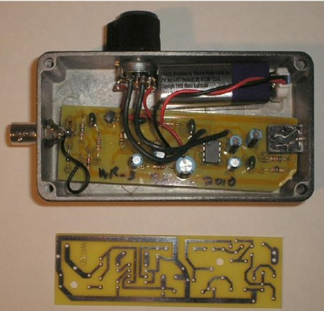
Space Environment and Weather
A solid-state detector will be used to measure the flux of electrons precipitating from the plasma sheet
Langmuir probe used to measure electron density and temperature of the ionosphere
Measurement at times of intense solar and/or ionospheric activity
Comparable payloads flew on sounding rocket MUSIC
Particle Detector
VLF Detector

Slide 14
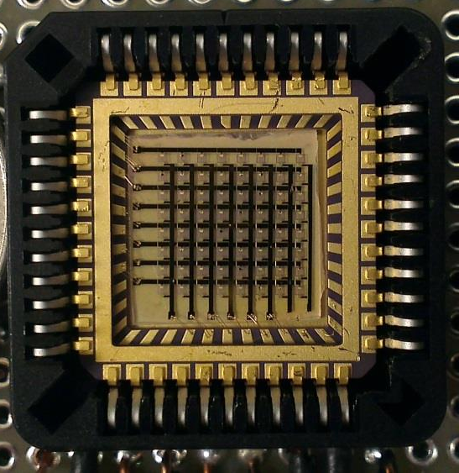
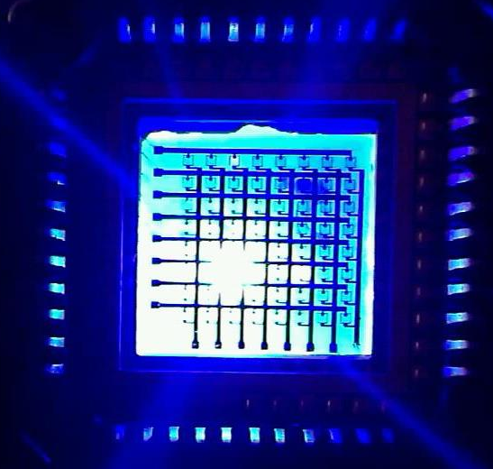
III-V Nitride-Based Materials
Precision optoelectronic sensor module containing arrays of LEDs and PDs can be used for short-range distance measurement and shape rendering
Due to the harsh environment of space, shielding is usually needed
  This shielding effects the range of these sensors
Levels of shielding will be tested over time to determine the optimum amount
Fabricated array of LEDs

Slide 15
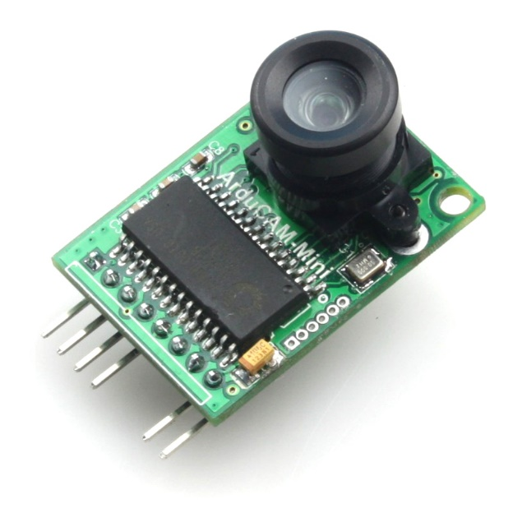
Earth Science Camera
ArduCam Mini OV2640
  2MP Sensor
  Filters can be applied pre-flight
Able to change settings on orbit
  Fully command-able via I2C and SPI
Allows us to:
  Verify deployment operations
  Assess COTS product in space environment
  Take pictures of the Earth and the atmosphere
ArduCam-Mini

Slide 16

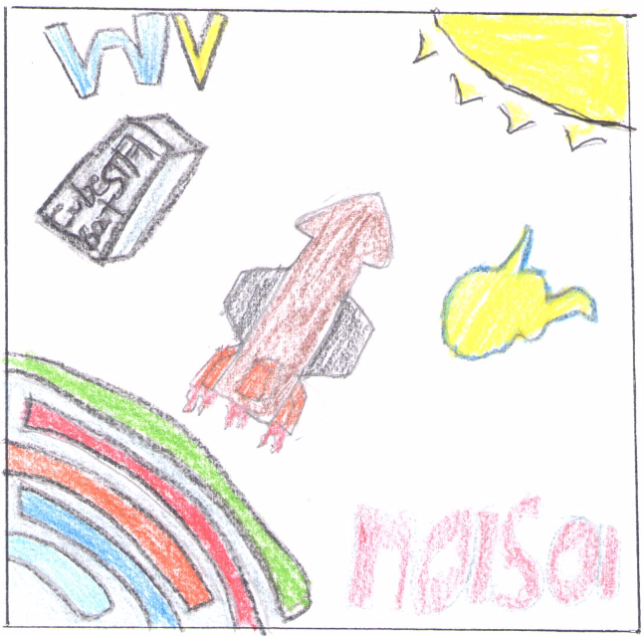
Statewide Outreach Plans and Programs
Website and Blog (www.stf1.com)
Spaceflight Mission Development course for WVU Undergraduates
STF-1 Mission Patch design competition
Educator’s Guide for teachers of K-12 students
NASA-Produced materials on space exploration, satellite operation, Space Station facts, etc.
Cardboard and 3-D printable models
Student Partnership for Advancement of Cosmic Exploration (SPACE)

