Slide 1
STF-1’s Environment
STF-1 will be launched from the ElAnA XIX Electron at 500 km above Earth’s surface.
Orbiting at around 500 km, STF-1 will be located in the thermosphere, where the outside temperatures range from 932°F to 3,632°F in sunlight, while they can drop to -60°F without direct sunlight. Inside STF-1, the temperature will range from -40°F to 185°F.
At this altitude, the temperature is almost entirely determined by solar activity and whether or not you are in contact with sunlight.
In the upper thermosphere, the density of air is so low that STF-1 doesn’t generate much drag.
However, over time, STF-1 will generate enough drag that its orbital altitude will decrease. As its altitude decreases, air density will increase, which further increases the amount of drag.
This process will continue until STF-1 eventually falls back to Earth after 5.2 years.
Simulation-to-Flight-1
NASA IV&V
Simulation-to-Flight 1
Justin Morris
Justin.R.Morris@nasa.gov
Matt Grubb
Matthew.D.Grubb@nasa.gov
Scott Zemerick
Scott.A.Zemerick@nasa.gov
John Lucas
John.P.Lucas@nasa.gov
dfgdfgdf
Additional Resources:
To learn more about STF-1 and keep up with our blogs, visit our website: www.stf1.com
For information on educational activities, webcasts, workshops, contests, internships, fellowships, and more, visit here: http://www.nasa.gov/audience/forstudents/current-opps-index.html
To learn about the WV Space Grant Consortium, visit here: http://www.wvspacegrant.org/
www.stf1.com

Slide 2
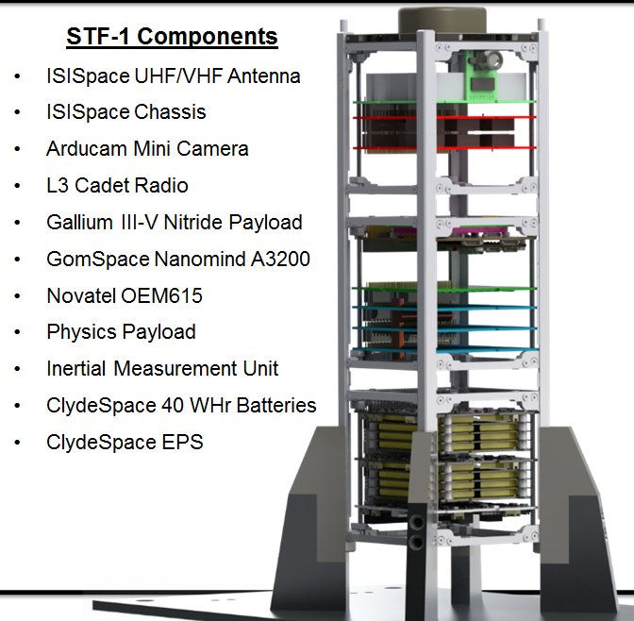
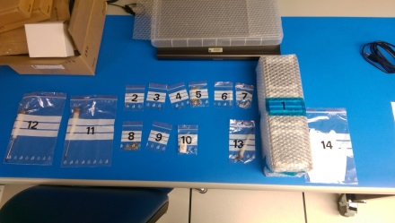
Interval View of STF-1
How Does STF-1 Function in Space?
Power
From the GPS to the camera to the radio, most everything on STF-1 requires electrical power to ensure that it properly functions.
However, due to the standardized size and weight of CubeSats, STF-1 could never carry enough batteries to power the entire mission.
Instead, STF-1 uses 5 solar panels, which provide power to the other systems through the electronic power system and 3 40WHr Batteries.
Communications
STF-1 will have a half-duplex radio onboard, along with a UHF/VHF Antenna.
The radio’s “store and forward” capability allows it to store up to 4 GB of information from the various experiments throughout each orbit.
Then, when the ground station is in sight during each orbit, the radio will transmit the stored data.
Additionally, the radio is equipped with a micro-processor that allows the ground team to communicate with the on board computer.
Ultimately, this system allows the CubeSat to relay data findings and receive commands from the ground team.
Computing
STF-1 will have a NanoMind A3200, which is comprised of the A3200 on-board computer (OBC), a magnetometer, and a gyroscope.
The OBC is the system that operates all space applications.
The magnetometer and gyroscope function together as an attitude stabilization system.
The computing systems of STF-1 enable it to stay functioning and in orbit.
STF-1 is West Virginia’s first spacecraft! This CubeSat, which is being built at NASA IV&V, aims to show the effectiveness of software simulation in the development process of CubeSats. Additionally, it will be completing several WVU-designed experiments while in space.
What are CubeSats?
Miniature satellites that use mostly commercially produced parts
Made up of 4x4x4.5 in. units that weigh no more than 3 lbs. each; Each unit is known as 1U
Made in multiples of 1U, 2U, 3U, or 6U
Primarily used for space research and testing new space technology
Advantages of CubeSats
Relatively low cost, simple to design and build, and short development time
A standardized shape and weight allows fairly inexpensive commercial parts to be employed rather than custom ones.
A widening set of available scientific functions due to an increasing number of CubeSat developers
Can be carried as a secondary payload in other spacecraft
Why is STF-1 Important?
The STF-1 team is creating, compiling, and using a group of open source computer programs, called NOS³, that can model all functions of CubeSats.
These programs will allow other teams to rely on inexpensive software simulations instead of tests that require expensive hardware.
Ultimately, this makes other team’s CubeSat development process both cheaper and faster.
Example of a COTS part, the ISISpace Chassis, which is used in STF-1

