Slide 1
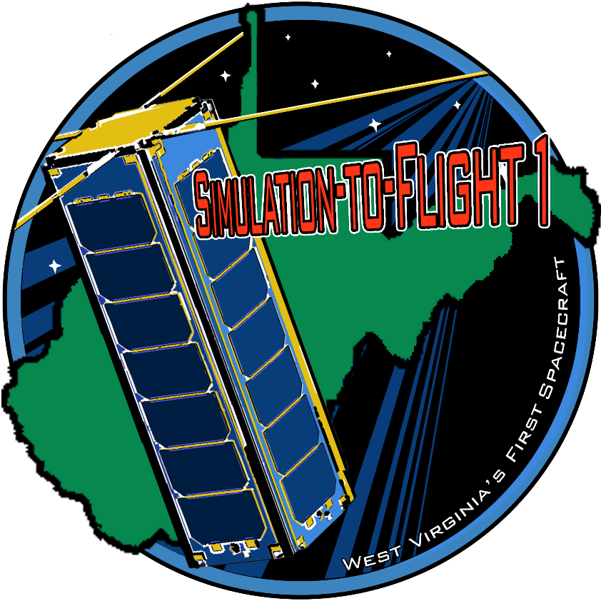
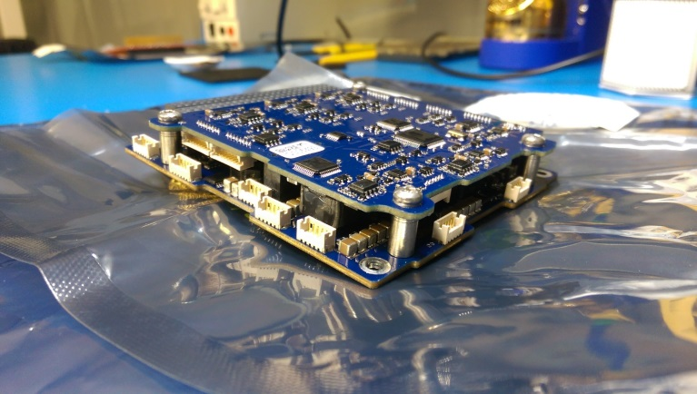
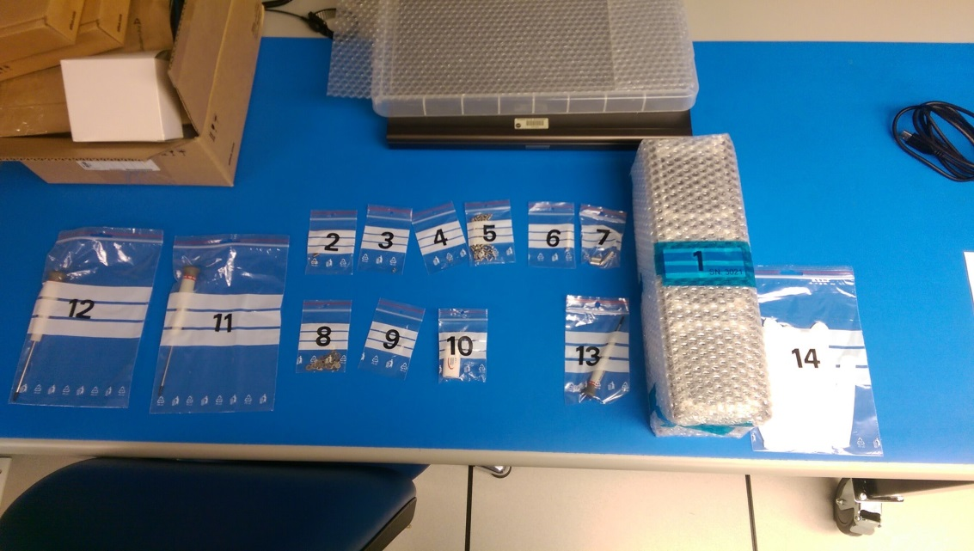
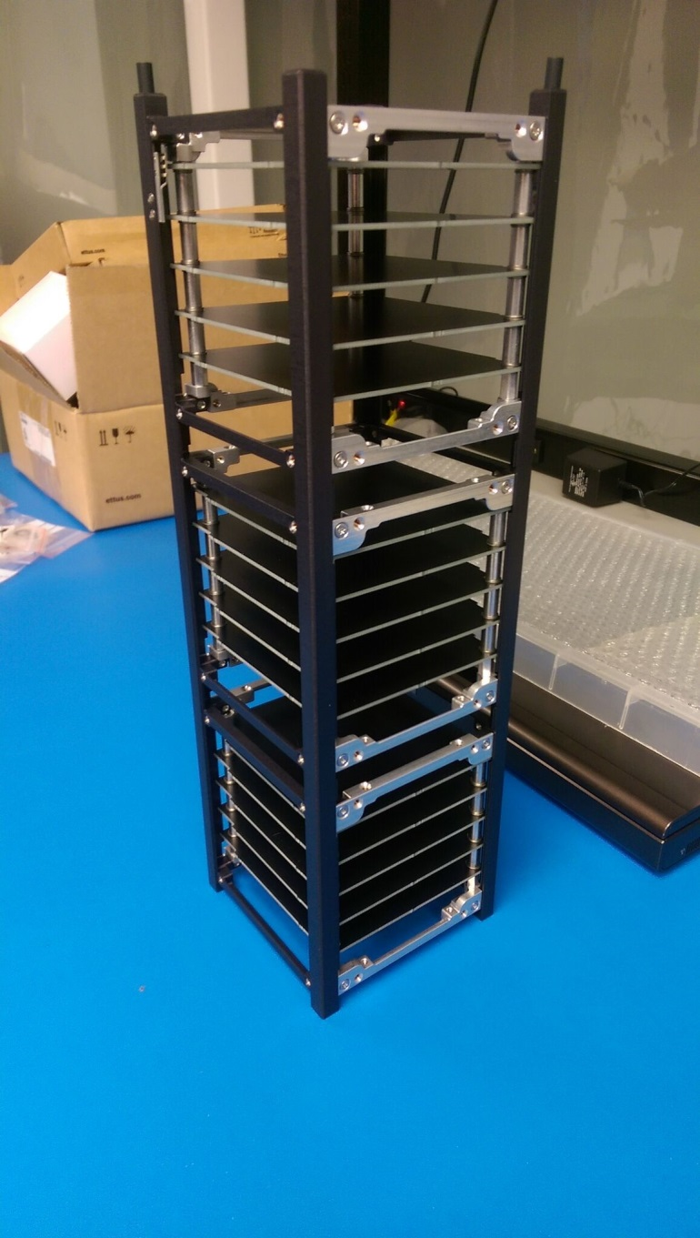
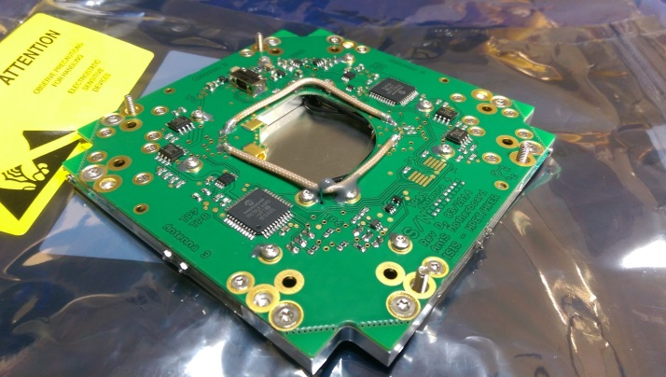
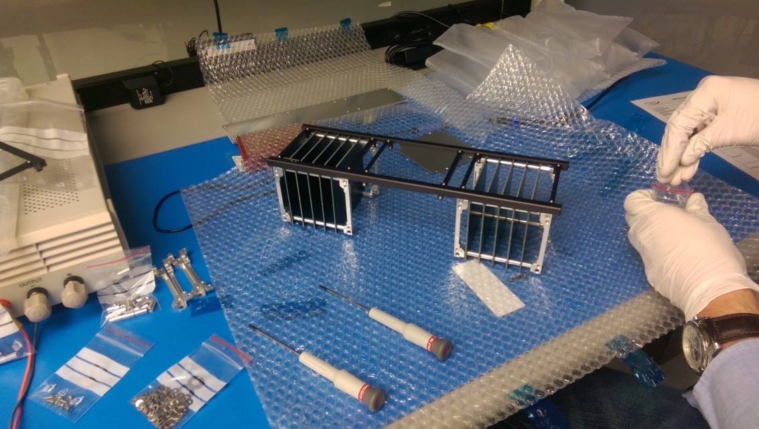
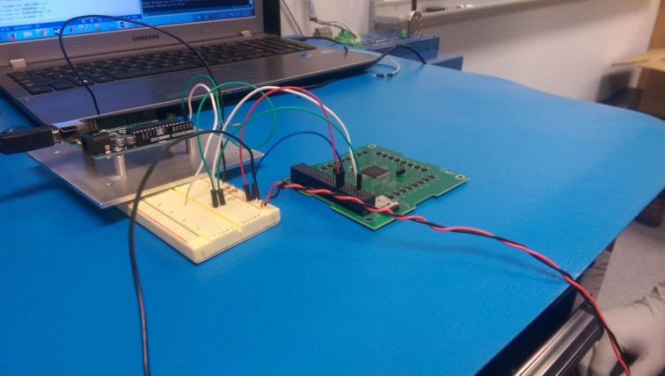
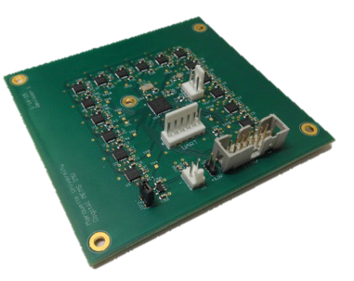
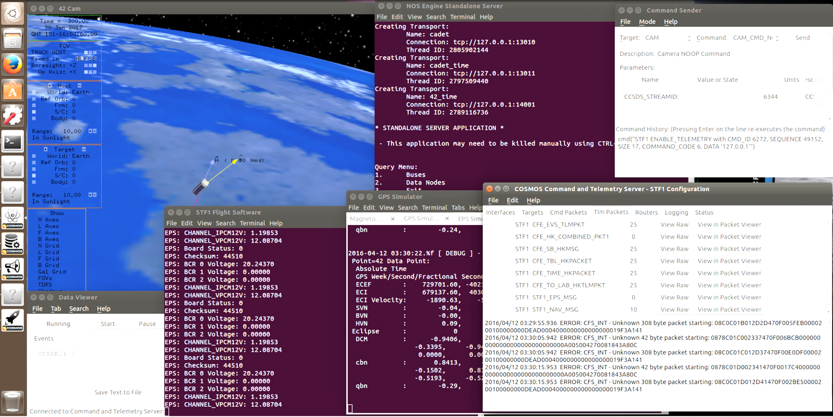
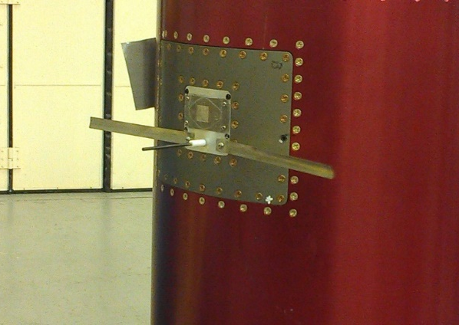
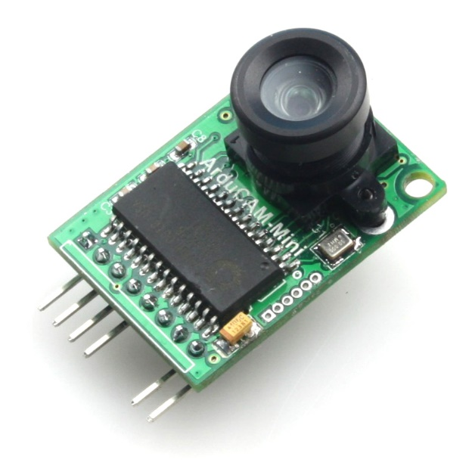
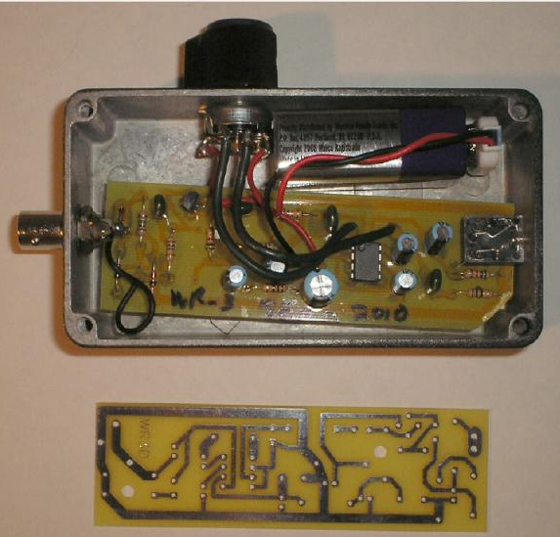
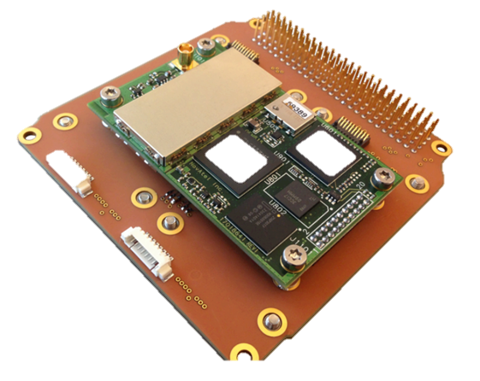
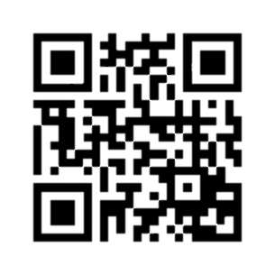
Simulation To Flight - 1
NASA CubeSat Launch Initiative (CSLI)
Anatomy of STF-1
West Virginia’s First Spacecraft
Introduction
The NASA CubeSat Launch Initiative (CSLI) is a project that provides opportunities for small satellites that address research in science, exploration, technology, or education to fly on rockets planned for upcoming launches. These small satellites, or CubeSats, are exactly what they sound like: miniature satellites with sizes ranging from about 4x4x4 in. to 4x4x24 in. and weights ranging from about 3 lbs. to 18lbs. In February 2015, the Simulation-to-Flight-1 (STF-1) project was selected for participation in NASA’s CSLI, meaning that the STF-1 team will get to create West Virginia’s First Spacecraft - a CubeSat - and send it to space!
As the project name suggests, the STF-1 team’s primary objective is to demonstrate how computer simulation technology can be used to help other teams create their CubeSats more efficiently. Basically, this means that the STF-1 team will put together a group of computer programs that allow other teams to use a computer to test how their CubeSats would function in real world situations. This will allow other teams to create their CubeSats more quickly and waste fewer resources while testing them.
ISISpace UHF/VHF Antennas
Deployable antenna system
Four alloy tape antennas
Up to 55cm in length
Dipole configuration for communications and Langmuir probe
Camera
2MP
Mounted to special services card
Optional filters to provide earth science data
Will fly on ElAnA XIX, Rocket Labs USA – Electron
Will deploy at 85 degrees inclination at 500km altitude
Mission Readiness Review: March 2017
Delivery: April 2017
Launch: June 2017
CADET Radio
Half duplex UHF
Store and Forward
4GB memory buffer
3.0Mbps w/18M dish
Assembly of STF-1
ISISpace Chassis
Modular structure
Each unit assembled independently
COTS component
Compatible with P-POD
Gallium III-V Nitride Payload
Three different LED carriers with different shielding levels
Measure effects of shielding
MEMS Inertial Measurement Unit
Micro Electro-Mechanical Systems (MEMS)
Accounts for errors through calibration
High quality inertial sensing with a MEMs IMU cluster
Physics Payload
Geiger Counter
Very Low Frequency (VLF) receiver
Plasma Probe
GomSpace Nanomind A3200
AVR32 w/ 512KB flash
125Mb NOR flash
32MB SDRAM
Novatel OEM625 GPS
On-orbit reprogrammable
Precise orbit determination
Data: 100-Hz phase, TEC, S4
Science Objectives
In addition to the primary mission, the STF-1 CubeSat hosts payloads for multiple science objectives. Three objectives are projects from a partnership with WVU, and the fourth is another objective from NASA IV&V. These science objectives are detailed in the row below.
ClydeSpace 40 WHr Batteries
Lithium Polymer
Independent for redundancy
Internal heaters
ClydeSpace EPS
10 command-able power switches
Provides 3.3V, 5V, and 12V
Optimized for Low Earth Orbit (LEO)
Three independent battery charge regulators (BCRs)
NASA Operational Simulator for Small Satellites (NOS³)
The suite of computer programs that the STF-1 team compiled
Open source software test bed for satellites, meaning that the original source code is made freely available and may be modified and redistributed by any user
Made up of flight system software, ground system software, a virtual development environment, a visualization tool, hardware models, and a common interface to tie it all together
Ultimately decreases development time of future CubeSat missions by lessening dependency on hardware resources through the use of software simulation
WVU Mechanical and Aerospace Engineering
WVU Physics and Astronomy
WVU Lane Department of Computer Science and Electrical Engineering
NOS³ in Action
MEMS IMU Swarm
MEMS Inertial Measurement Units
Designed to overcome Size, Weight, and Power (SWaP) constraints that are caused by CubeSats
Made up of a cluster of IMUs with the idea that averaged results will be incredibly accurate
Gen-2 IMU Cluster flew on sounding rocket in late 2015
Gen-3 (STF-1 version) will be custom-built for the CubeSat
Magnetosphere-Ionosphere Coupling
Depends primarily on electromagnetic and convective stresses from the magnetosphere on the ionosphere resistivity
A solid-state detector will be used to measure the flux of electrons precipitating from the plasma sheet
Over the polar caps, the detector will effectively measure solar energetic particle fluxes
Accuracy relies on IMU and magnetometer data
III-V Nitride-Based Materials
A precision optoelectronic sensor module containing arrays of light-emitting diodes (LEDs) and photodiodes (PDs) can be used for short-range distance measurement and shape rendering
Utilizing materials known for their radiation hardness and the ability to operate at extreme temperatures
Due to the harsh environment of space, shielding is usually needed to ensure reliability and functionality
Less shielding allows for better range of measurement
Levels of shielding will be tested over time to determine the optimum amount to extend capability in the space environment
GEN-2 IMU Cluster
Space Weather
A Langmuir probe will be used to measure electronic density and temperature of the ionosphere
Effects of the space environment on technologies such as spacecraft are collectively called space weather
High fluxes of precipitating particles and high-temperature plasma can produce surface and deep dielectric charging on a CubeSat
Measuring these at times of intense solar and/or ionospheric activity is the goal for research and education programs at WVU
NASA IV&V
Additional Resources
Global Navigation Satellite System (GNSS) Receiver and Precise Orbit Determination (POD)
Model: NovAtel OEM615 GPS Receiver
Focus to develop and assess estimate strategies that will maximize POD accuracy form data obtained during duty-cycled operations
Processing of collected data will use NASA technology called JPL’s GIPSY-OASIS package
Langmuir Probe and VLF
Earth Science Camera
Model: ArduCam Mini OV2640
2MP sensor
Able to configure on orbit
Fully command-able
Allows the mission to:
Verify deployment operations
Assess products in space environment
Observe Earth’s surface and atmosphere over mission lifetime
Integrate visualization into NOS³
Outreach Plans and Programs
To learn more about STF-1 and keep up with our blogs, visit our website: www.stf1.com.
For information on educational activities, webcasts, workshops, contests, internships, fellowships, and more, visit here: http://www.nasa.gov/audience/forstudents/current-opps-index.html
To learn more about the WV Space Grant Consortium, visit here: http://www.wvspacegrant.org/
GPS Mounted to Motherboard
VLF detector to be miniaturized

